Slide 1




FELIX MUKUNGU
Founder, The Core
Bitcoin Eductor
Graphic Designer
MukunguFelix
Felix Divoar
felixdivoar

Slide 2
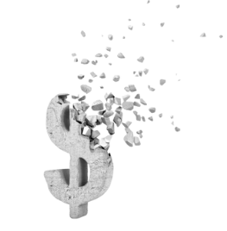
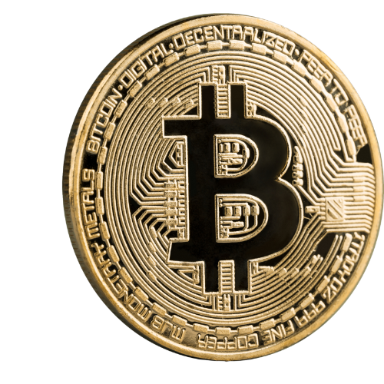
Bitcoin holds transformative potential challenging traditional views.
Course explores flaws in financial system, offering solutions for individual empowerment.

Slide 3
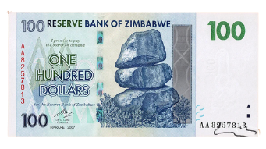
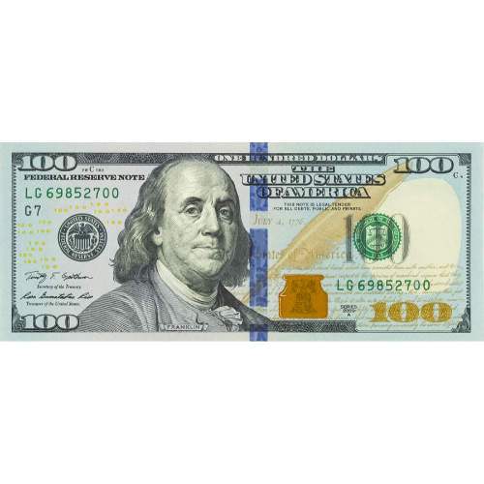
A
OR
B
What makes one bill so desirable and another one as good as trash?
What gives money its value?
Where does money come from and who decides how much of it to print?
Why not print more money and distribute among everyone equally?
Is money backed by Gold or any other commodity?
How many people use cash anyways?

Slide 4
Scarcity, forces us to weigh pros and cons of how we use our resources and
Make trade-offs
Scarcity, illustrated in a desert scenario, demands trade-offs and influences decisions in various aspects of life.
There are two types of scarcity
Man made scarcity
Natural Scarcity
Man made scarcity - also known as centralized scarcity. Include things like
Limited edition designer bag, rare sports card.

Slide 5
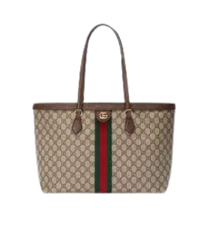
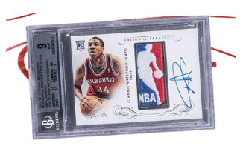
Limitation
Can easily be replicated or counterfaited
Natural Scarcity - Also know as decentralized scarcity, includes things like
Salt, shells and precious metals.

Slide 6
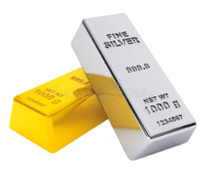
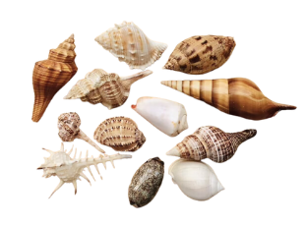
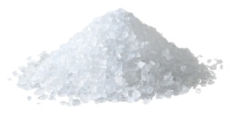
The main difference between natural and man-made scarcity is Contral. Man-made scarcity is controlled by a company or government while natural scarcity is decentraized, not controlled by anyone
Scarcity illustrated in desert scenario, influencing decisions in various life aspects.

Slide 7
Time Preference
Referes to the idea that people generally prefer to have something now
Rather than later
Would you have $100 today or $110 a year later ?
Opportunity Cost
The value of the next best alternative that you give up when making
a decission
In the desert example, the opportunity cost of drinking all the water right away is the survival benefit you would have gained from rationing the
Water for longer period of time.

Slide 8
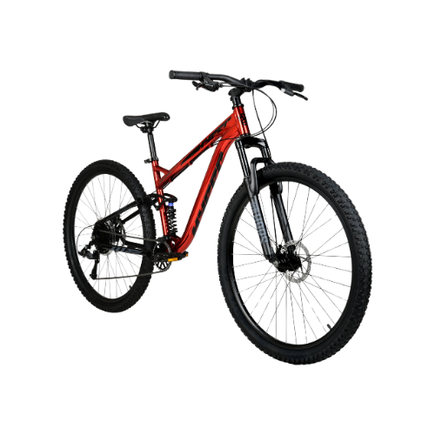

Saving $10 daily to buy a bike in 2 weeks
Buying $10 daily
Money - Is a way to exchange goods and services. It represents
The value of those items in a form that can easily be
traded.

Slide 9
Tranansactions
Is exchange or transfer of goods and services. It is a way of exchangnging value between two or more parties
Money is the value BY which goods are exchanged. Money is
not the NOT the value FOR which goods are exchanged

Slide 10
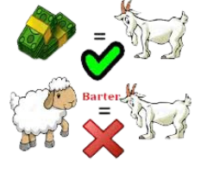
Functions Of Money
Making Exchange easy
You don’t have to find someone who wants exactly what you have to trade

Slide 11
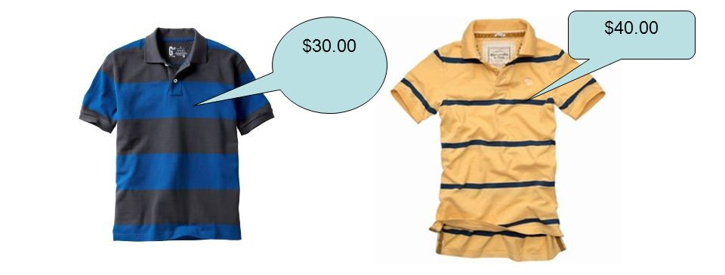
Unit of account
Provide a universal standard of value that allows people to express & compare the price of different goods & services

Slide 12
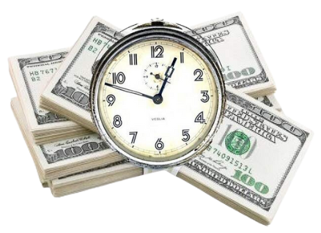
Store of Value
Money should maintain it’s value making it useful as a way to save and invest value of human labor

Slide 13
Characteristics of Money
Durability - Ability of money to resist physical deterioration and
Last overtime.
Portability - Refers to the ease with which money can be transported
and carried around
Scarcity - Refers to the limited supply of money, which helps to
Maintain its value and prevent us from having to spend
More money to buy the same amount of goods
Acceptability - Refers to widespread acceptance of money as a form
Of payment.
Fungibility - refers to interchangeability of money, so that one unit of
Money is equivalent to another unit of the same value

Slide 14
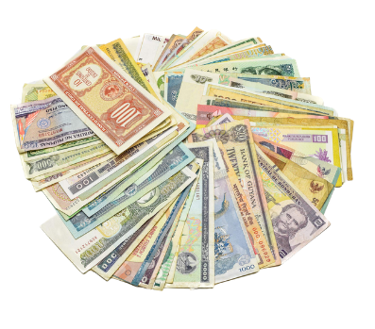
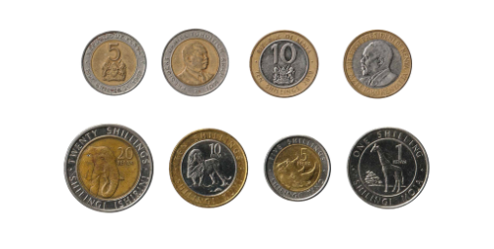
Characteristics of Money
Divisibility - Refers to the ability of money to be divided into smaller
units , so that people can use it to make purchases of
varying amounts.
Types Of Money
Fiat Money - Money issued by the government and is accepted as
a medium of exchange, even though it is not backed
by any physical commodity.

Slide 15
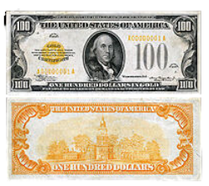
Representative Money - a claim on a physical commodit. Like fiat
money it can also be a paper bill (i,e gold
Or silver certificate) but unlike fiat, it is
Backed by physical commodity, society
Consider valuable.

Slide 16
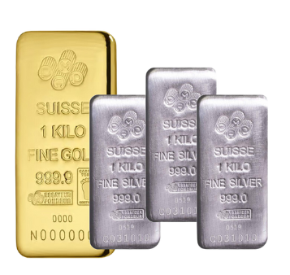
Commodity Money- is a physical object that has intrinsic value and
Is widely accepted as a medium of exchange
Gold and silver fit into this category.

Slide 17
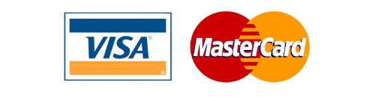
Electronic Currencies
Are a type of money that can be used for online transactions.
Digital Payments rails in the traditional financial system consist of the
Technology and systems that enable electronic payments to be processed, such as bank servers, data bases and secure networks
Card Networks - These are networks that facilitates transfer of funds
between financial institutions and merchants.

Slide 18
Digital Currencies
Bitcoin
Distributed software that allows for transfer of value using a currency protected from unexpected inflation without relying on
trusted third parties.
bitcoin (small ‘b’)
Native currency for the Bitcoin Network

Slide 19
0 = Terrible; 3 = Okey; 5= Excellent
Characteristics of good Money | COWS | CIGARETTES | DIAMONDS | EUROS | BITCOIN
Durable
Portable
Uniform
Acceptable
Scarce
Divisable

